Slide 1
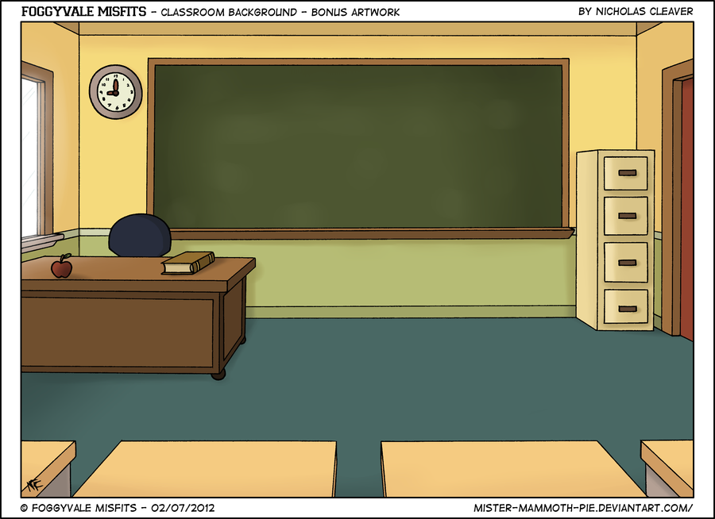
MINI CLASS
By~
Vineet S. Bisht
Chirag Gulati
Jaivardhan S. Rana
Shubham Soni

Slide 2

Introduction:
An easy to use pocket class experience for students and professors alike
The students would manage clearing their doubts by active open discussions with the professors.
Sharing of study material by the professors to the students.
Live lectures and downloads provided for students who are unable to attend classes.
Fun and interactive quizzes based on subjects with monthly updated leaderboards for students to compete in.

Slide 3
Requirements:
Software ~
Databases: MySql/LDAP
JRE: Java Runtime Environment (v8 or later).
LAN/INTERNET: Internet connection would be required for the application to work.
Operating Systems: Windows, Linux, Mac and Android(v4.0 or later).

Slide 4
Hardware ~
Processor: Pentium(R) Dual – Core CPU or later
Keyboard: 108 Key keyboard
Mouse: Optical Mouse
Camera: (For professors only)

Slide 5
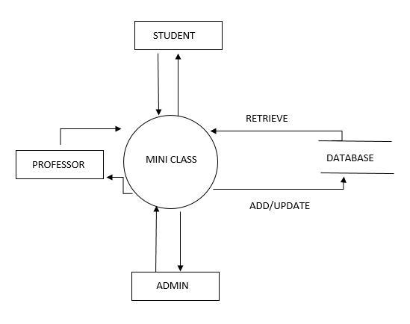
Simplified DFD (Level 0)

Slide 6
Key Points:
Live subjective discussions.
Live lecture streaming and downloading.
Daily updated quizzes for students.
Secure Connection.
Schedule Notification for professors and students.
Portability.
Latest technology used.

Slide 7
Methodology

Slide 8
Software Application
Made using the latest JavaFx 8.
Interactive UI with user based access controls.
Interacts with the web server to gain access to the databases for authentication and authorization.
Separate interactive tools for the professors and students.
Comprises of discussion forums, quizzes and class related study material.
Live streaming and downloading feature for students

Slide 9
Android:
Created for Android(v4.4) or later using Android Studio on the NetBeans environment.
Comprises of discussion forums, study material and optional class notifications for students and professors.
Live streaming and downloading of lectures.
Can also participate in subject based quizzes to compete in monthly leaderboards.

Slide 10
Robustness:
Every data transfer has been encoded using AES encryption algorithm.
User Names would be pre-stored in the ldap databases for elimination of false identity theft.
Software has been created using Java therefore any operating system with Java( v8 or later) installed would be able to use its features.
Kerberos has been used with Ldap to provide authentication and authorization services.

Slide 11
Conclusion:
This project aims at creating a rich and fun interactive class environment for the students as well as the professors.
This would also help the shy students to express themselves to the teachers without getting dominated by the other students.
Live streaming would also help the students who miss their class to keep updated with the latest class progression without being left behind.
Having a common hub would help the professors share study material as well as update assignments, project submission related queries and other such matter.

